Slide 1
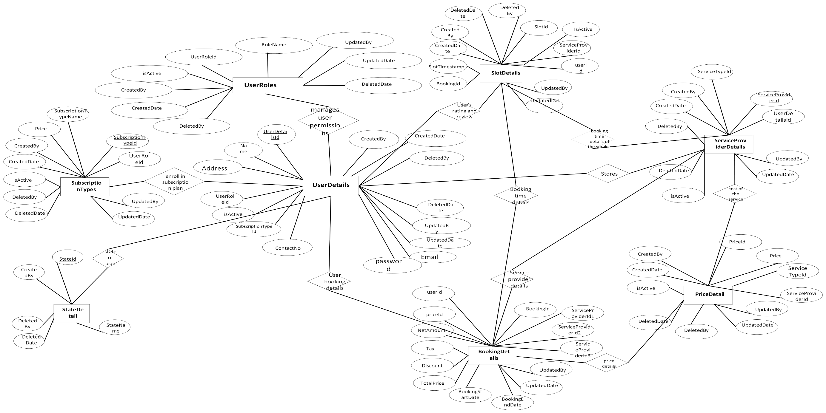
ER Diagram: MaidEase Iteration3

Slide 2
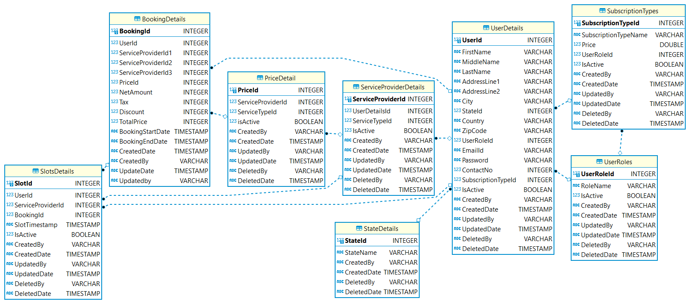
Logical Diagram: MaidEase Iteration3

